Slide 1
Introduction to Psychology
Amna Nisar
Clinical Psychologist
Speech and language pathologist

Slide 2
COMPLAINCE
Compliance is the act or process of complying to another person’s desire, demand or proposal.

Slide 3
LETS HAVE A EXAMPLE OF A SOFTWARE
Software are developed in compliance with specifications created by a standards body, and then deployed by user organizations in compliance with a vendor's licensing agreement.

Slide 4
OBEDIENCE
Obedience, in human behavior, is a form of social influence in which a person yields to explicit instructions or orders from an authority figure“.

Slide 5
What causes obedience?
People justify their behavior by assigning responsibility to the authority rather than themselves.
People define the behavior that’s expected of them as routine.
People don’t want to be rude or offend the authority.

Slide 6
CONFORMITY
Conformity is the most common and pervasive form of social influence. It is informally defined as the tendency to act or think like members of a group. In psychology, conformity is defined as the act of matching attitudes, beliefs, and behaviors to group norms

Slide 7
Group

Slide 8
Group
What is a group?
Two or more individuals
Who interact with one another
Are interdependent upon one another
Aware of belonging to a group

Slide 9
The purpose of a group
There are a number of reasons for forming a group:
Time efficiency
Effective use of resources
Social opportunities
Better decisions and outcomes
Peer support.

Slide 10
Types of Groups
Formal Groups
Informal groups
Command group : formal group determined by structure
Task group: formal group organized for a specific task
Committees: handles problems outside of regular assignments
Social groups: people who enjoy each other’s company (chat groups)
Interest groups: groups that develop informally around a common interest (news groups, listserv members)

Slide 11
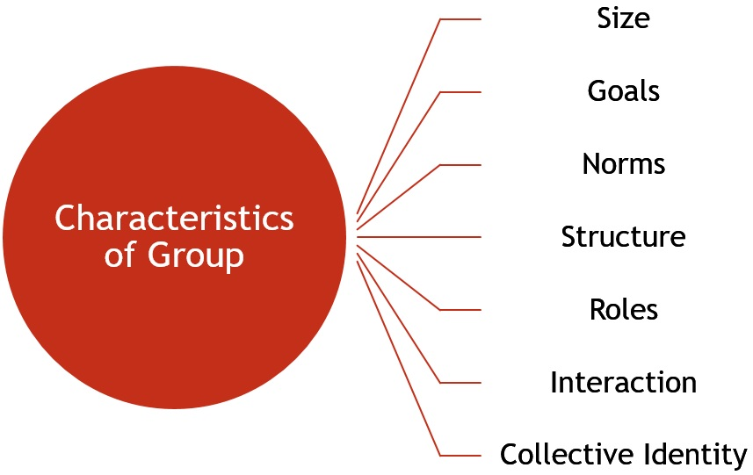
Characteristics of Group
Notes:
11

Slide 12
Stages of Group Development
Forming:
At this stage, the formation of a new group begins, wherein the members come together and get to know each other through the interactions.
Storming:
Once the forming stage is over, the individuals will start interacting with each other in the context of the task to be achieved.
Norming:
Here, everybody works cohesively towards the target and appreciate each other’s experience and skills.

Slide 13
Stages of Group Development
Performing:
At this stage, synergy gets created between the team members, where everyone works towards the accomplishment of a goal. This stage is characterized by flexibility and interdependence.
Adjourning:
This is the last stage of group development, where the group is terminated, and the group members are separated from each other. Every group is created for a purpose, and once the purpose is fulfilled the group is adjourned.

Slide 14
How Groups Influence behavior (impact on decision mAKING)
Groups influence individual decision-making processes in a variety of ways, such as:
Groupthink
Group shift
Deindividuation
GROUP POLARIZATION

Slide 15
Groupthink:
A psychological phenomenon that occurs within groups of people, in which the desire for harmony in a decision-making group overrides a realistic appraisal of alternatives.
“Go with the flow”

Slide 16
Example of group think
A marketing team unanimously supports a high-budget campaign idea proposed by the CEO despite some members having reservations. Fearing opposition, they suppress doubts, leading to an expensive and ineffective campaign. This illustrates groupthink, where the desire for harmony overrides critical evaluation, resulting in poor decision-making and significant losses.

Slide 17
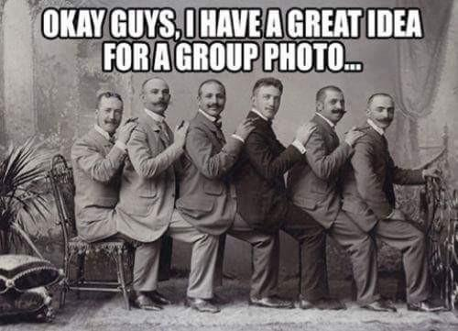

Slide 18
Group shift:
GrouP shift is the phenomenon in which the initial positions of individual members of a group are exaggerated toward a more extreme position.
When people are in groups, they assess risk differently than they do when they are alone. In the group, they are likely to make riskier decisions as the shared risk makes the individual risk seem to be less.

Slide 19
when the fans of a sports team celebrate the win of their team and their celebration turns to destruction of property.

Slide 20
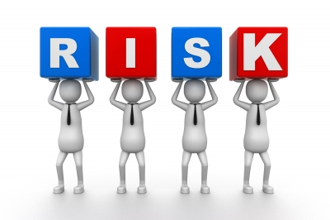
Shared Risk

Slide 21
Deindividuation:
Individuals’ loss of self-awareness when in a group.
Larger the group, higher the incidence of deindividuation.
People tend to do things, that without the group for support, they would not normally do (even criminal activities)

Slide 22
Group polarization:
Group polarization is the tendency to shift toward more extreme positions after group discussion
Risky
Neutral
Cautious
Notes:
22

Slide 23
Example of group polarization
a group of women who hold moderately feminist views tend to demonstrate heightened pro-feminist beliefs following group discussion.

Slide 24
Group Productivity:
Are groups more productive than individuals?
What do you think?

Slide 25
impact of group dynamics on decision making and productivity
Groupthink, group shift, group polarization, and deindividuation negatively impact decision-making and productivity by fostering conformity, extreme viewpoints, and loss of individual accountability, leading to poor decisions, inefficiency, and reduced innovation. These dynamics undermine critical thinking and balanced judgment.

Slide 26
Social loafing:
Social loafing refers to the concept that people are prone to exert less effort on a task if they are in a group versus when they work alone.

Slide 27

Pictorial representation of Social Loafing

Slide 28
Social Facilitation
Social facilitation The tendency for people to perform simple or well-learned tasks better when others are present. The strengthening of dominant (prevalent) responses in the presence of others. D. Myers

Slide 29
Norman Triplett (1898) found that cyclists times were faster when racing with others than when they were racing alone. So he conducted an experiment in which he asked children to wind fishing reels as quickly as they could. He found that children who worked alongside a competitor, wound the reel faster.

Slide 30
Role of social facilitation in decision making
In group decision-making, this can enhance productivity and performance for well-practiced or simple tasks due to increased arousal and motivation. However, it may also lead to anxiety and hinder performance on complex tasks, potentially causing rushed or suboptimal decisions as individuals might prioritize speed or conformity over thorough analysis.

Slide 31
Thank you

